Slide 1

Project Title: Contract Monthly Claim System - Part 3 Enhancements
ST10456858 – Khumo Tswai PROG6212 - Programming 2B
Date – November 2025

Slide 2

Project Overview s Part 3 Focus
Project Evolution:
Part 2: Basic MVC claim management system
Part 3: Enterprise-level enhancements with HR workflow Part 3 Key Focus Areas:
HR Super User Role with centralized user management
Automated data flow (removed manual rate input)
Entity Framework database integration
Enhanced session-based security
Comprehensive unit testing (44/44 tests passing)
Business rule validation (180-hour limit)

Slide 3


Feedback- Driven Improvements

Slide 4
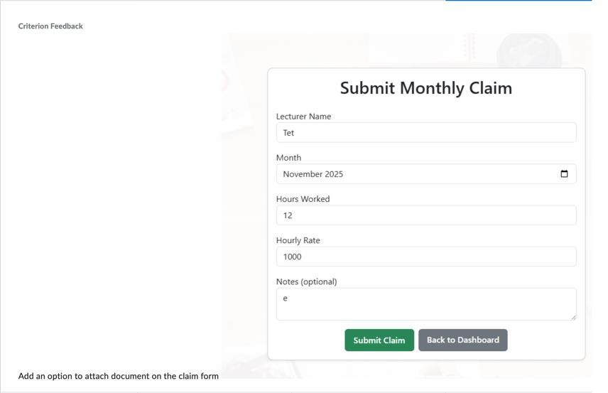


Feedback-Driven Improvements
Adding an option to attach document on the Claim Form
Before applying adjustments

Slide 5
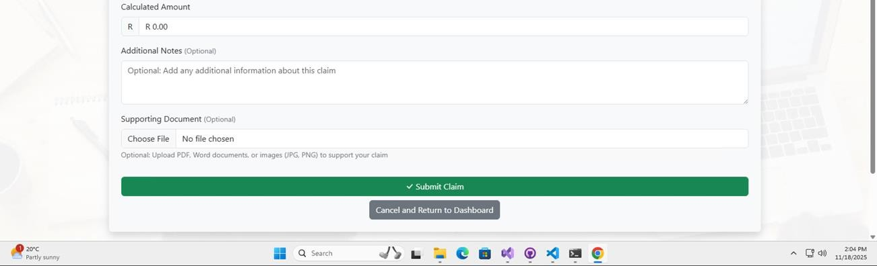
Feedback-Driven Improvements
Adding an option to attach document on the Claim Form
After applying adjustment
Implemented the option to attach a supporting document in the Claim Form

Slide 6
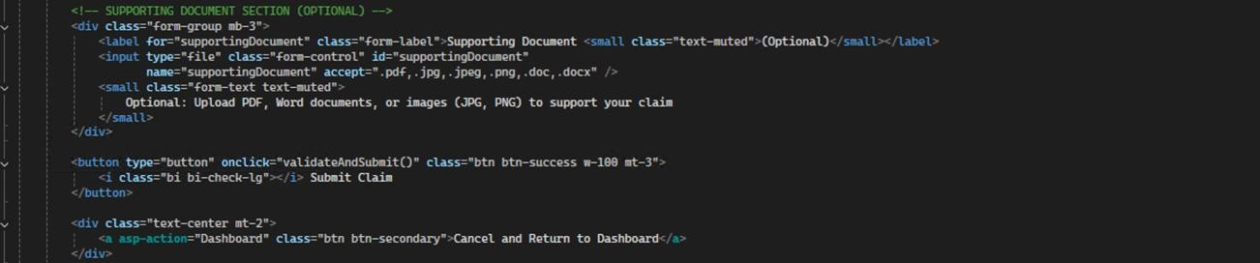
Feedback-Driven Improvements
Adding an option to attach document on the Claim Form
After applying adjustment
Technical Implementation:

Slide 7

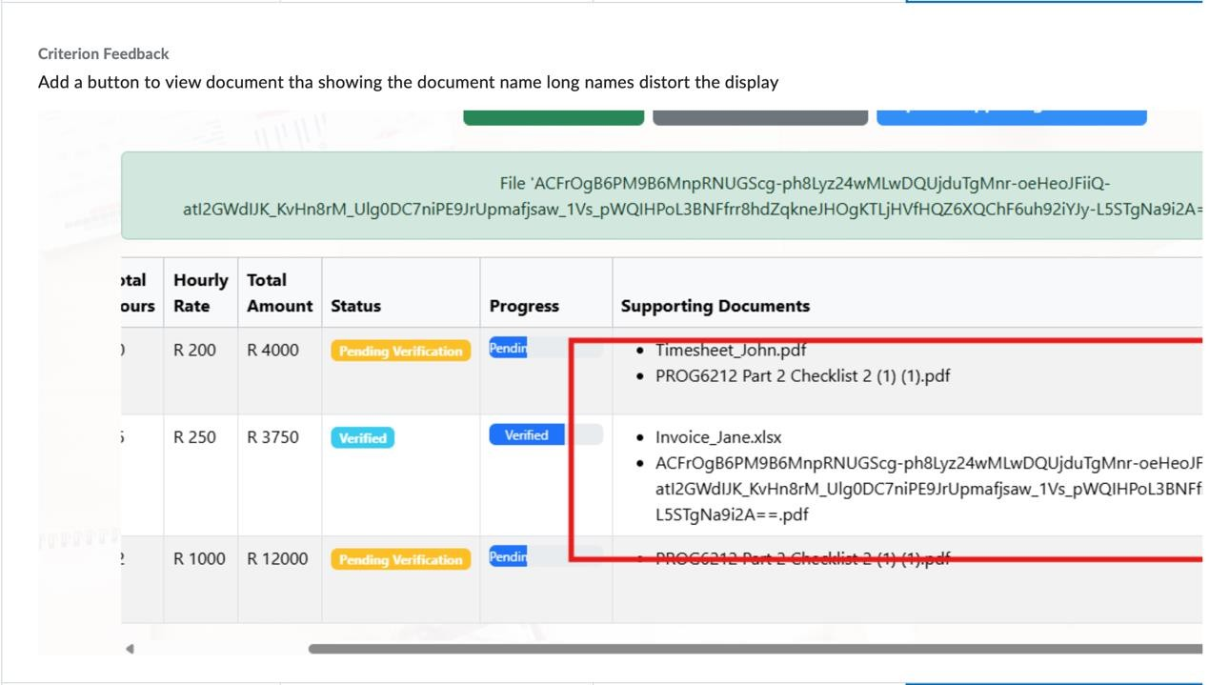
Feedback-Driven Improvements
Document Display Issue
Before applying adjustments

Slide 8
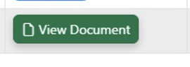
Feedback-Driven Improvements
Document Display Issue
After applying adjustments
Implemented a View Document Button to view the supporting document submitted in the Claim submission and and viewed in a new tab

Slide 9

Feedback-Driven Improvements
Document Display Issue
After applying adjustments
Technical Implementation

Slide 10

HR Super User Implementation

Slide 11
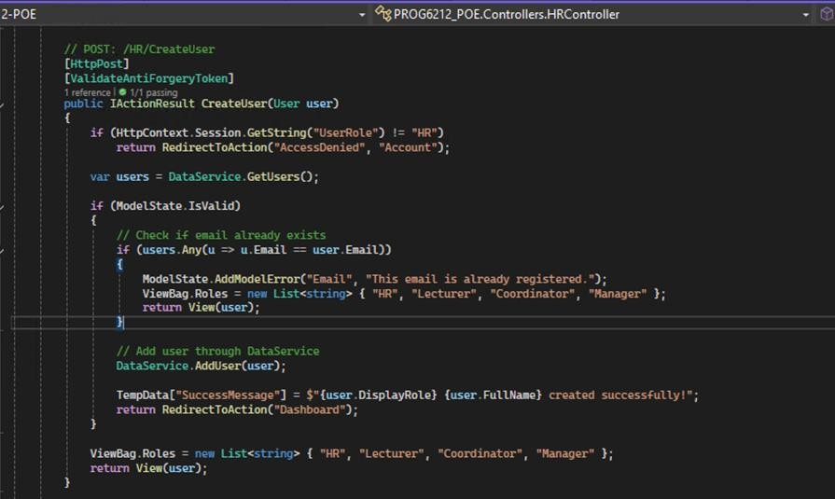
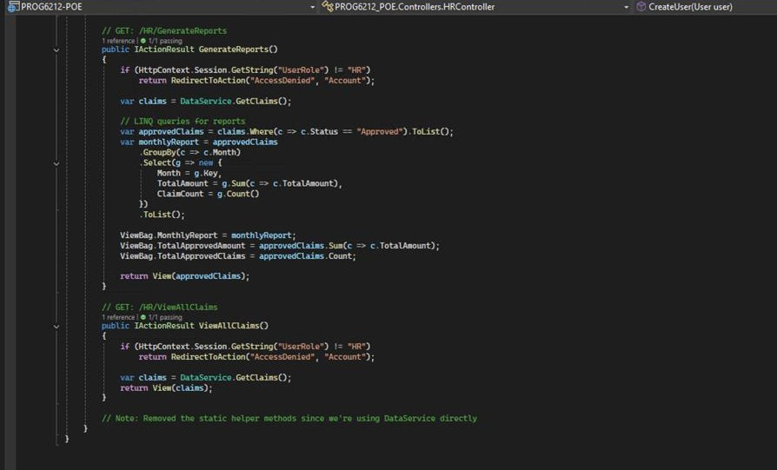
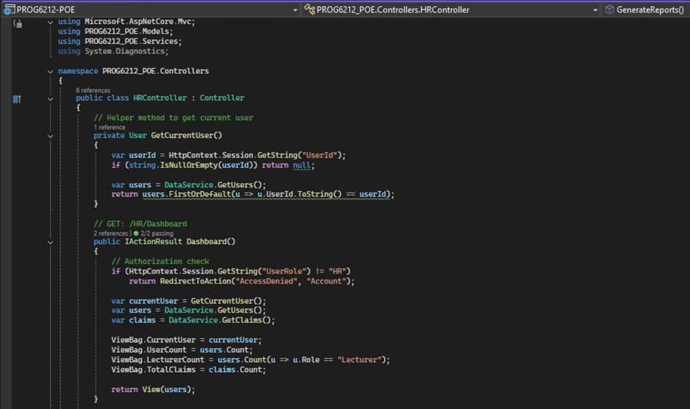
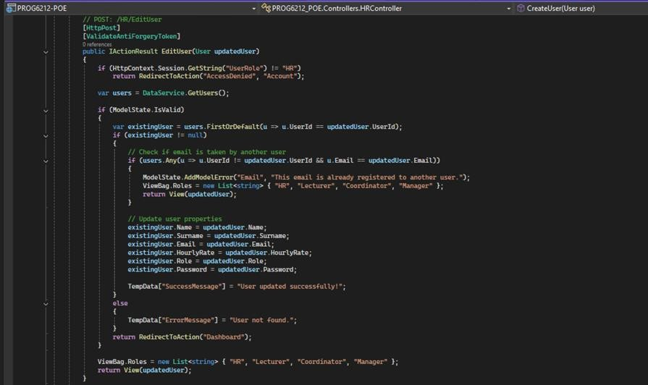
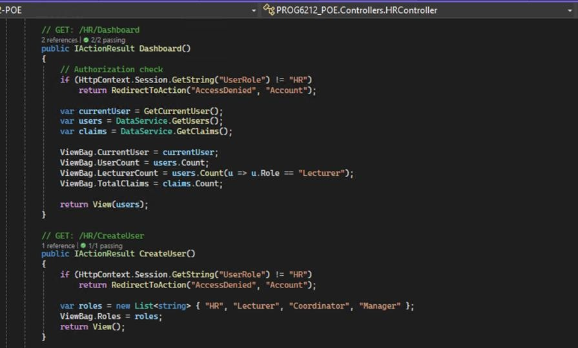
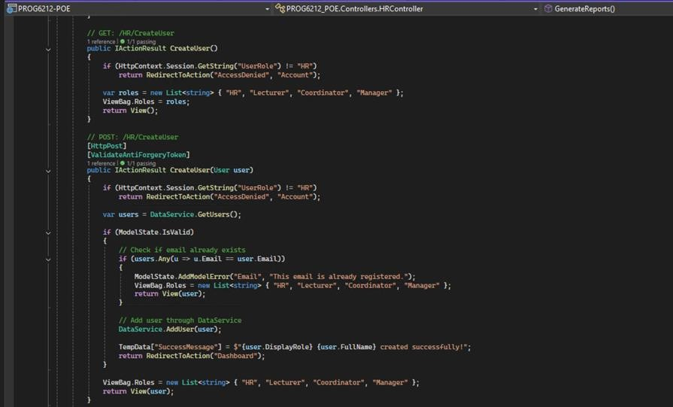
HR Super User Implementation
HR Super User Role
Centralized user profile management
No public registration system
Complete CRUD operations for users
Automated report generation Benefit:
Controlled, secure user management system

Slide 12
Automated Data Flow s Calculations

Slide 13
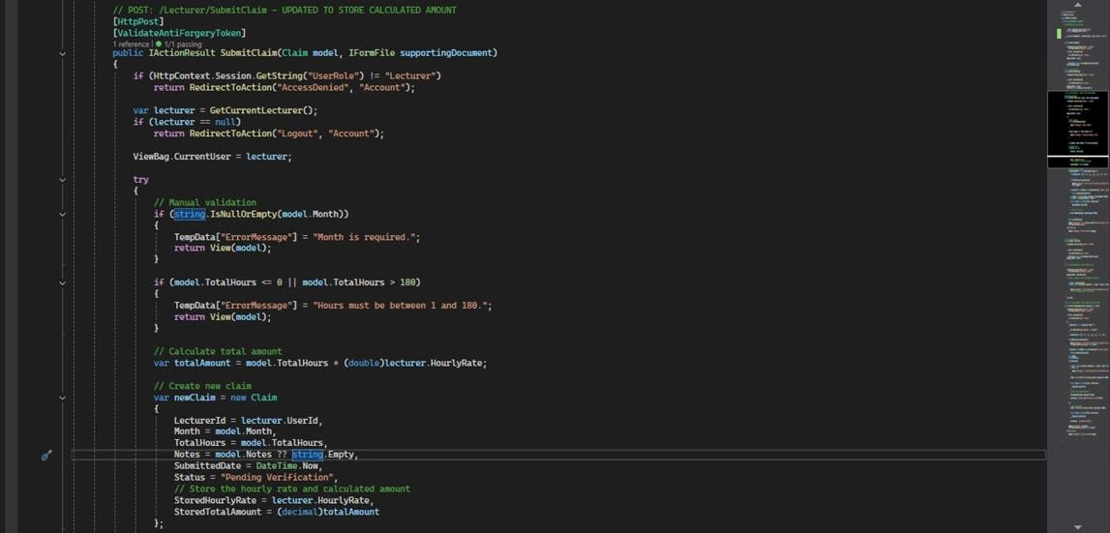


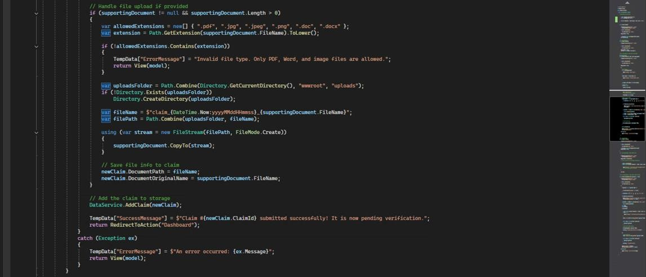
Automated Data Flow s Calculations
Features:
Hourly rates pulled from HR- managed profiles
Real-time total amount calculation
Eliminated manual input errors

Slide 14
Enhanced Validation s Business Rules

Slide 15
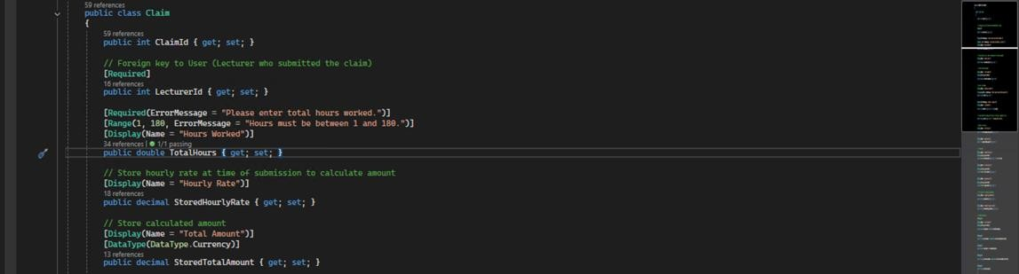
Enhanced Validation s Business Rules
Security Features
Session Authentication: HttpContext.Session.GetString("UserRole")
Role-Based Authorization: Each role has specific access
Access Control: Redirect to AccessDenied for unauthorized users
Data Isolation: Users only see their own data Maximum 180 hours per month validation

Slide 16
Comprehensive Unit Testing

Slide 17

Test Coverage
All Controllers: Account, Lecturer,
Coordinator, Manager, HR
Business Logic: Claim validation
and calculations
Security: Role-based access control
Session Management: User authentication states
Data Integrity: Model validation rules
Comprehensive Unit Testing

Slide 18
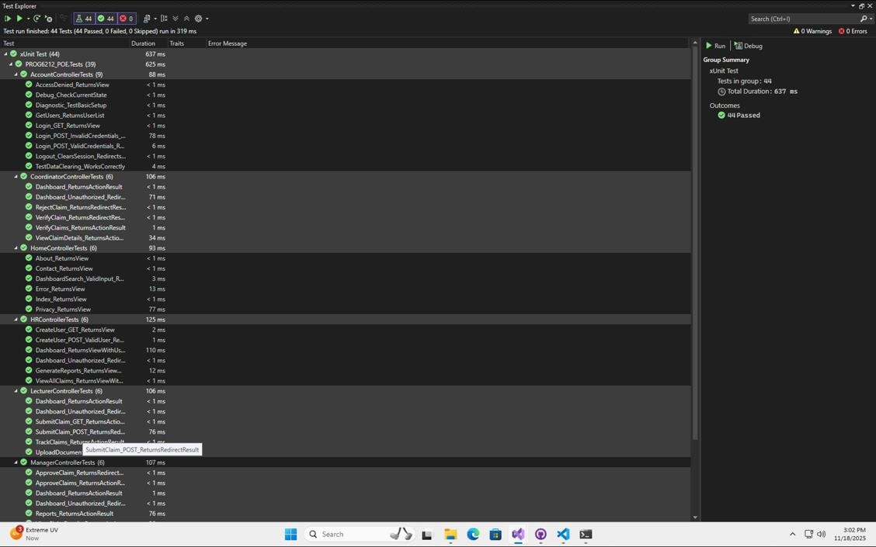

Comprehensive Unit Testing
Running Test

Slide 19
Entity Framework Integration

Slide 20
Data Flow
HR creates users with hourly rates
Lecturers submit claims with auto-calculated amounts
System stores rates and amounts permanently
Admins process claims through workflow
Entity Framework Integration

Slide 21
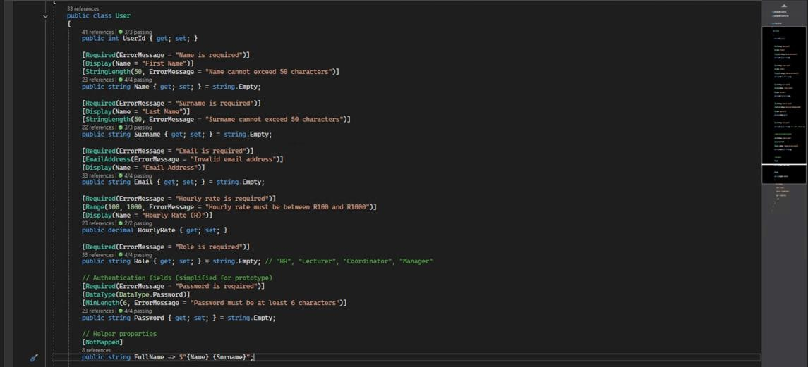
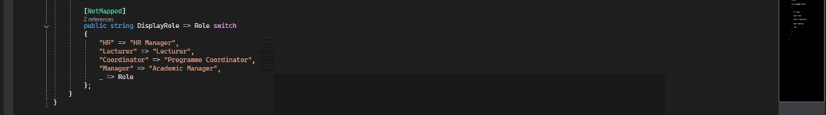


Entity Framework Integration
User Model

Slide 22
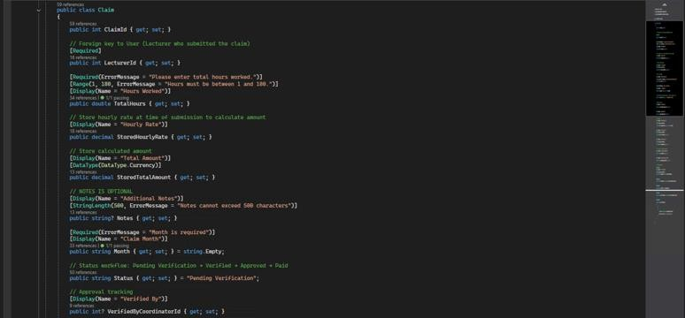
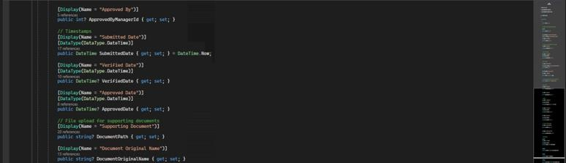
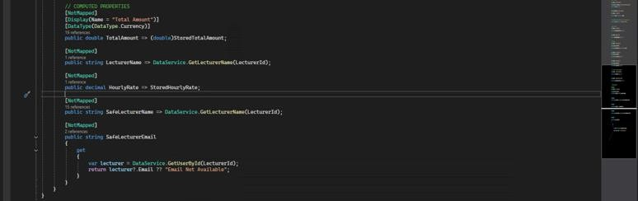
Entity Framework Integration
Claim Model

Slide 23
Data Validation s Business Rules

Slide 24
Business Logic Enforcement:
Hourly Rate Control: HR sets rates
(R100-R1000 range)
Work Hour Limits: Maximum 180
hours per month
Role Management: Strict role-based system
Data Integrity: Required field validation
Audit Trail: Permanent storage of calculated values
Data Validation s Business Rules

Slide 25
Required Field Validation
[Required(ErrorMessage = "Name is required")] [Required(ErrorMessage = "Email is required")] [Required(ErrorMessage = "Role is required")]
2. Business Rule Enforcement
Data Validation s Business Rules
// HOURLY RATE BUSINESS RULE
[Range(100, 1000, ErrorMessage = "Hourly rate must be between R100 and R1000")] public decimal HourlyRate { get; set; }
// ROLE MANAGEMENT BUSINESS RULE public
string Role { get; set; } = string.Empty; // Strict role system: "HR", "Lecturer", "Coordinator", "Manager"

Slide 26
3. Data Format Validation
[EmailAddress(ErrorMessage = "Invalid email address")] [StringLength(50, ErrorMessage = "Name cannot exceed 50 characters")] [DataType(DataType.Password)] [MinLength(6, ErrorMessage = "Password must be at least 6 characters")]
Data Validation s Business Rules
User Experience Enhancements
[Display(Name = "First Name")] [Display(Name = "Hourly Rate (R)")] [Display(Name = "Email Address")]

Slide 27
Automated Calculation System

Slide 28





Automated Calculation System

Slide 29
Automated Calculation System
Implementation:
// AUTO-CALCULATION FROM HR-MANAGED DATA [HttpPost] public IActionResult SubmitClaim(Claim model)
{
var lecturer = GetCurrentLecturer();
// REAL-TIME CALCULATION
var totalAmount = model.TotalHours * (double)lecturer.HourlyRate;
// STORE FOR AUDIT TRAIL
var newClaim = new Claim
{
StoredHourlyRate = lecturer.HourlyRate, StoredTotalAmount = (decimal)totalAmount, Status = "Pending Verification"
};
}

Slide 30
Technical Architecture

Slide 31


Technology Stack:
ASP.NET Core MVC Framework
Entity Framework Core (Code-First)
xUnit Testing Framework
Session-Based Authentication
Bootstrap UI Framework
Technical Architecture
Architecture Pattern:
Model-View-Controller (MVC)
Repository Pattern with DataService
Layered Security Architecture
Role-Based Access Control
Scalability
Enterprise-ready solution

Slide 32
Version Control

Slide 33
GitHub Development Practices
Frequent, descriptive commits
Feedback-driven iterations
Professional workflow management
Regular pushes to repository
Version Control

Slide 34
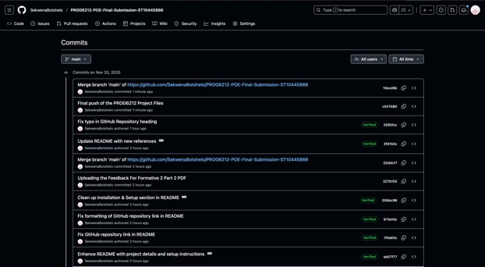
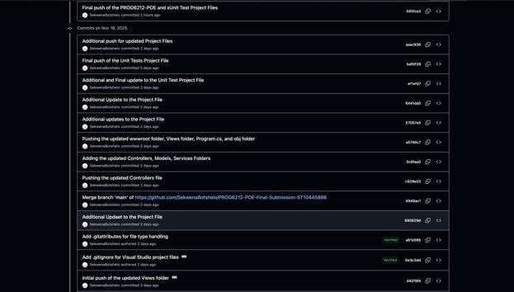

Version Control
GitHub Commits:

Slide 35
User Workflow Demonstration

Slide 36
HR Workflow
Login → Manage Users → Generate Reports
Lecturer Workflow
Login → Submit Claim (Auto-calculated) →
Track Status
Coordinator Workflow
Login → Verify Claims → Update Status
Manager Workflow
Login → Approve Claims → View Reports
Benefits
Streamlined, role-specific user experiences
User Workflow Demonstration

Slide 37
Challenges s Solutions

Slide 38
Challenge 1
Data consistency across multiple roles
Solution
Centralized HR user management system
Challenge 2
Secure session management
Solution
Challenges s Solutions
Custom authorization with role validation
Challenge 3
Automated calculations
Solution
Real-time computation with stored HR rates
Challenge 4
File upload and display
Solution
Button-based document viewing system

Slide 39
Future Enhancement Opportunities

Slide 40
Potential Extensions
PDF report generation with LINQ queries
Email notification system for status updates
Advanced analytics dashboard with charts
Mobile-responsive design optimization
API integration for external systems
Advanced reporting capabilities
Future Enhancement Opportunities

Slide 41



Conclusion

Slide 42

Project Success Summary:
HR Super User System
Centralized user management
Automated Data Flow
Real-time calculations from HR rates
Enhanced Security
Role-based access control C sessions
Comprehensive Testing
44/44 unit tests passing
Entity Framework
Conclusion
Robust database integration
Feedback Implementation
Document attachment C display fixes
Business Rules
Validation C workflow enforcement
Professional UI/UX
Streamlined user workflows

Slide 43

QsA

Slide 44
Thank You! Questions?
Contact Information:
Student Name:
Khumo Tswai
Student Number:
ST10456858
Module Code:
PROG6212
Programming 2B
GitHub Repository Link:
QsA

